Slide 1

Copy right @ 404NOTFOUND

Slide 2
index
> Introduction
> Game concept in a nutshell
> Core features of game
> Scope and potential issues
> Q&A

Slide 3
introduction

Slide 4




MEMBERS
> Jung Hye Rin (정혜린)
- Level designer
> Kim Ha Gyeong (김하경)
- Producer
> Son Hae Won (손해원)
- Lead programmer
> Son Ju Hye (손주혜)
- Assit programmer

Slide 6
WHAT IS DIGI-GO?
concept

Slide 7
* DIGI-GO is arcade catching game about student's effort to graduate Digipen.
|F|
|A+|
|B|
| grade |
| total |
B
B
\____/
\O/
| |
/ \

Slide 8
FEATURES

Slide 9
score
|F|
|A+|
|B|
\_____/

Slide 10
progress
________________
| |
| | | |
| |
| |
| | | |
|______________ |
|F|
|A+|
|B|
| grade |
| total |
B
B
♥
\____/
\O/
| |
/ \
Stage : 1 2 3 4

Slide 11
Scope and potential issues

Slide 12
Time line
November
APPLY ARROW KEY TO MOVE
1
2
GET GRADE
MAKE CHARACTER & MAP
3
4
GRADE CALCULATION
December
EDIT
5
6
ADD EXTRA

Slide 13
EXTRA (Additional factors if time is available)
______________
| |
| | | |
| |
| |
| | | |
|_____________ |
|F|
|A+|
|B|
\____/
\________/
♥
♥
\____/
\O/
| |
/ \
Assignment : get five B grades
Reward : + 0.5 grade
Stage : 0 1 2 3 4 / 5 6 7 8 9

Slide 14
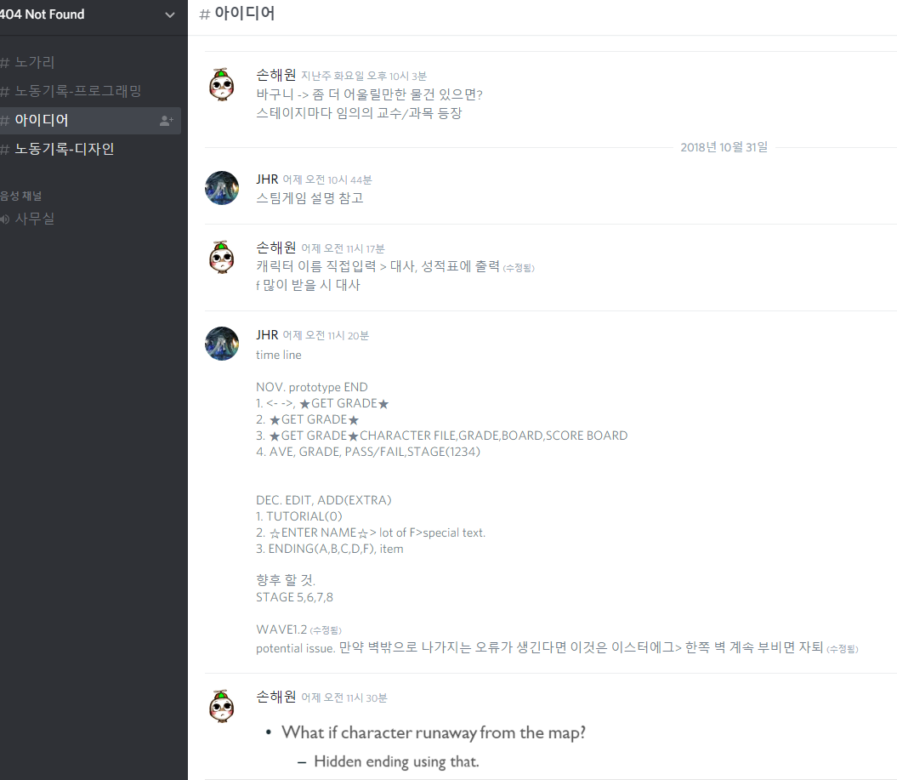
Potential issue
_______________
|
| |
|
|
| |
|_______________
|F|
|A+|
|B|
\____/
\O/
||
/ \

Slide 15
Q & a

Slide 16
Copy right @ 404NOTFOUND

